Slide 1
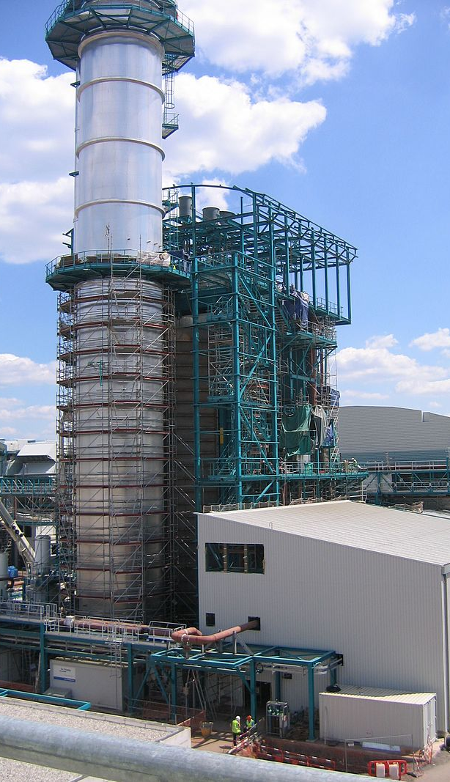
PC 4 Heat engines
PHY 555 – Energy & Environment
Erik Johnson, Mathieu de Naurois, Daniel Suchet

Slide 2
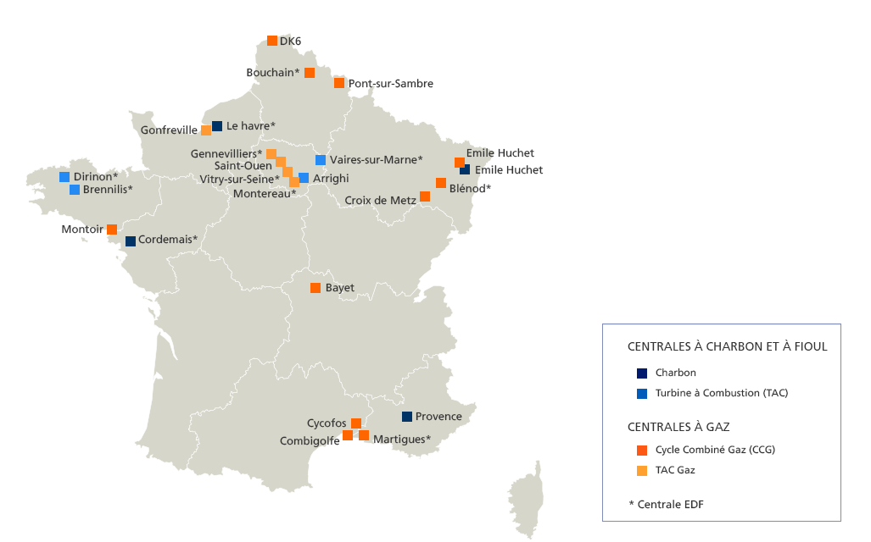
French focus
Heat engines
Source: EDF

Slide 3
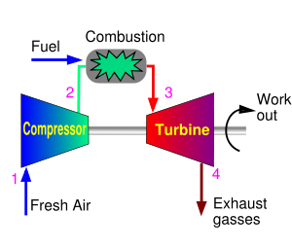
The Joule – Brayton cycle
1⇒2: adiabatic compression of air in the compressor
2⇒3: isobaric combustion
3⇒4: adiabatic expansion in the turbine
4⇒1: isobaric cooling at exhaust

Slide 4
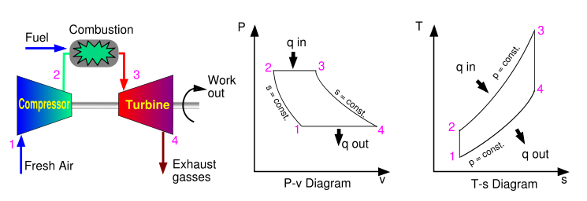
The Joule – Brayton cycle
1⇒2: adiabatic compression of air in the compressor
2⇒3: isobaric combustion
3⇒4: adiabatic expansion in the turbine
4⇒1: isobaric cooling at exhaust

Slide 5
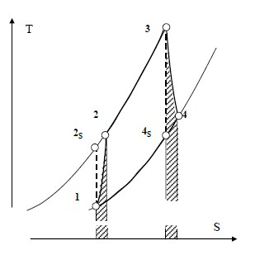
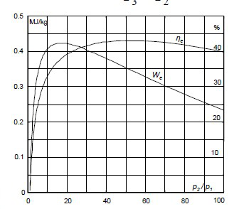
Non idealities

Slide 6
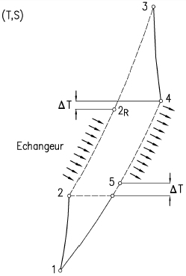
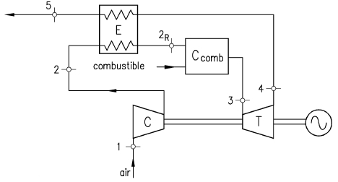
Improvements

Slide 7
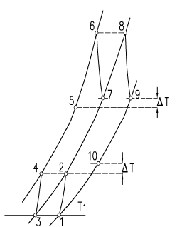
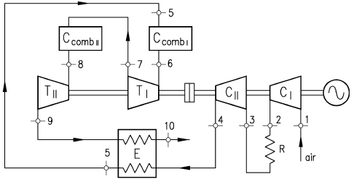
Improvements

Slide 8
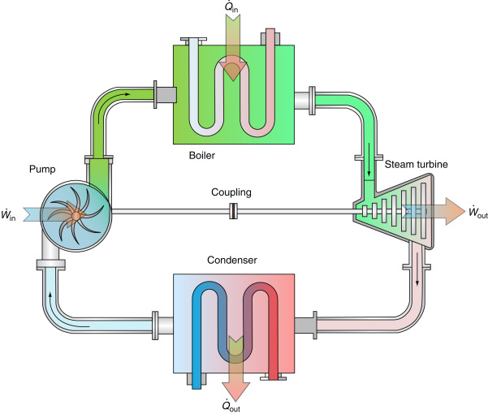
The Clausius - Rankine cycle
adiabatic compression of water (pump)
isobaric heating of pressurized water (boiler)
vaporization at constant pressure (boiler)
reheating (isobaric) of vapour (superheater)
adiabatic expansion (turbine)
isobaric condensation (condenser)

Slide 9
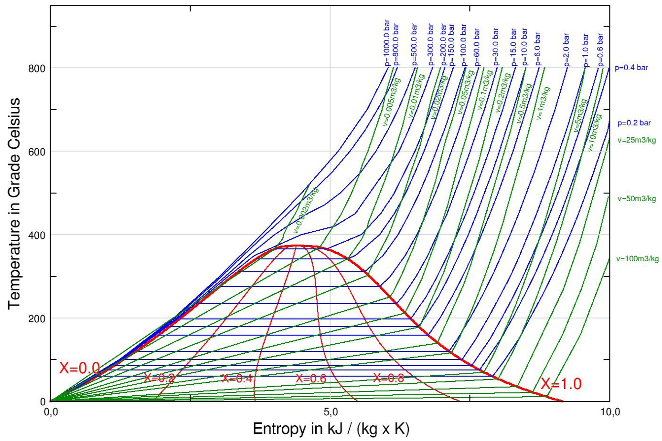
T-S diagram for phase change

Slide 10
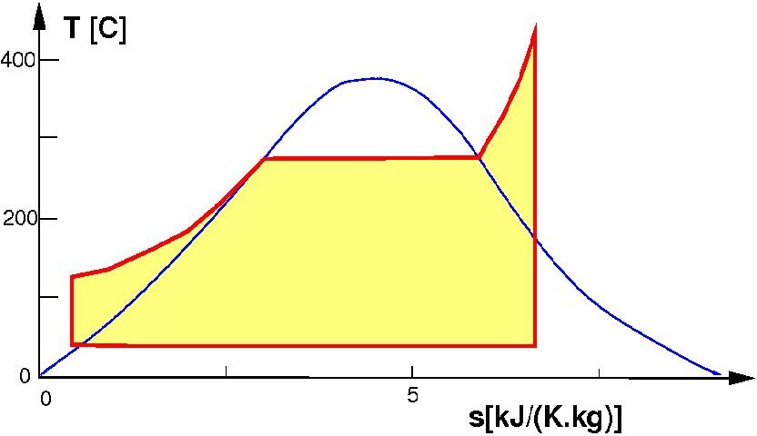
The Clausius - Rankine cycle (T-S)
adiabatic compression of water (pump)
isobaric heating of pressurized water (boiler)
vaporization at constant pressure (boiler)
reheating (isobaric) of vapour (superheater)
adiabatic expansion (turbine)
isobaric condensation (condenser)

Slide 11
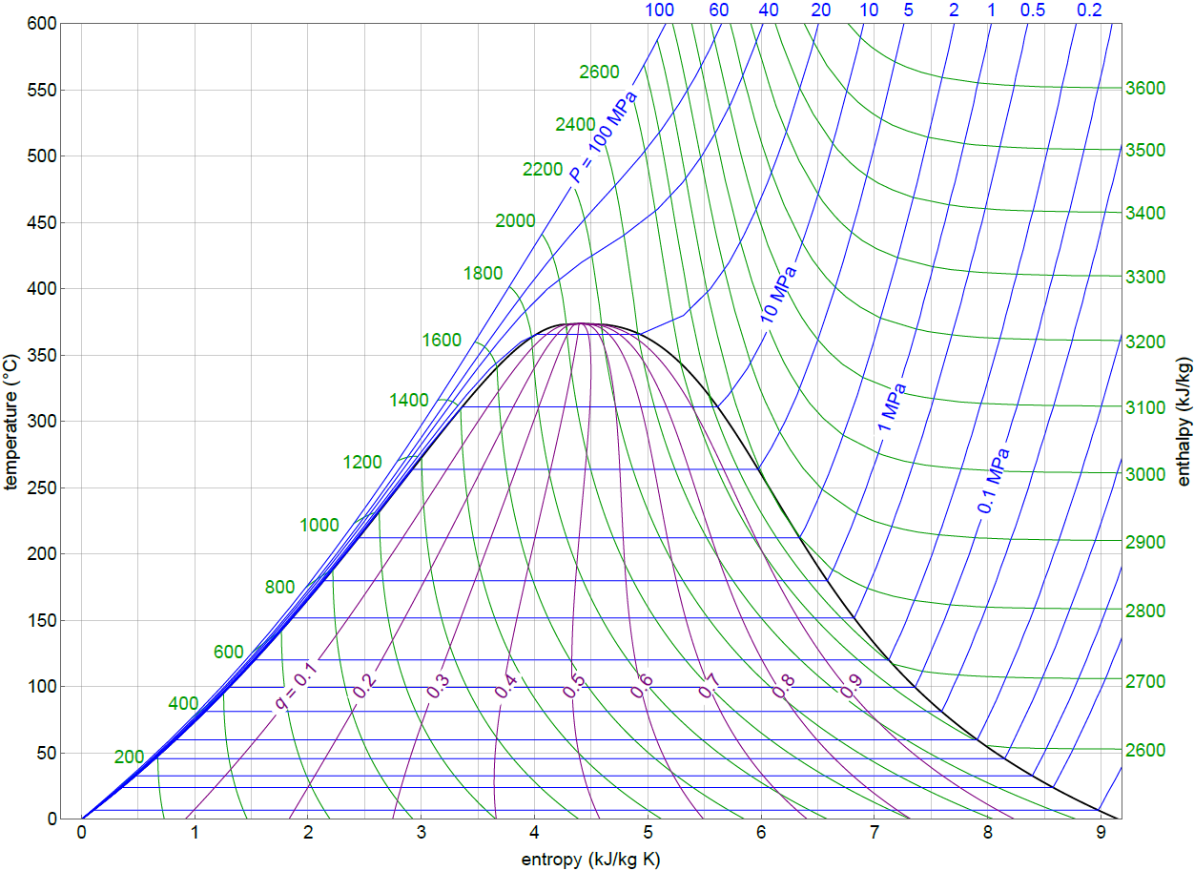
T-S diagram for water

Slide 12
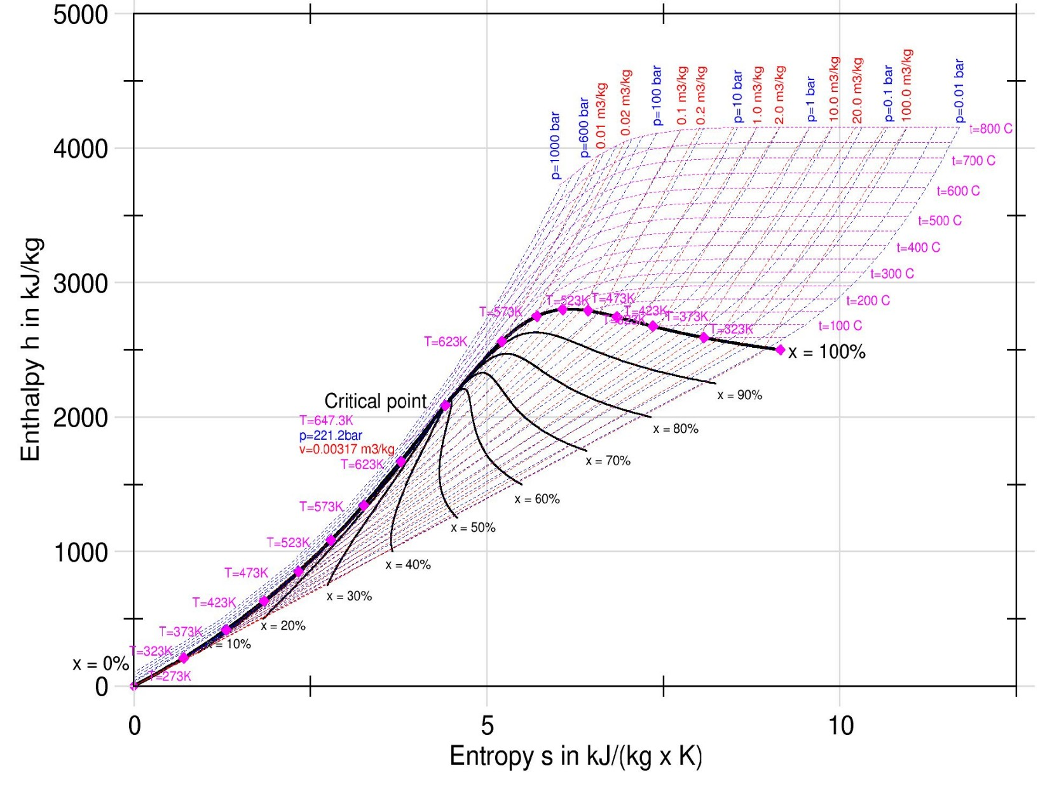

Slide 13
Adiabatic expansion
Isobaric Heating
Isobaric Condensation

Slide 14
W
Q_{in}
$$r=\frac{4,66}{11.77}=0.40$$
Notes:
En fin de détente, on est en phase mixte: mélange de gouttelettes d'eau et de vapeur

Slide 15
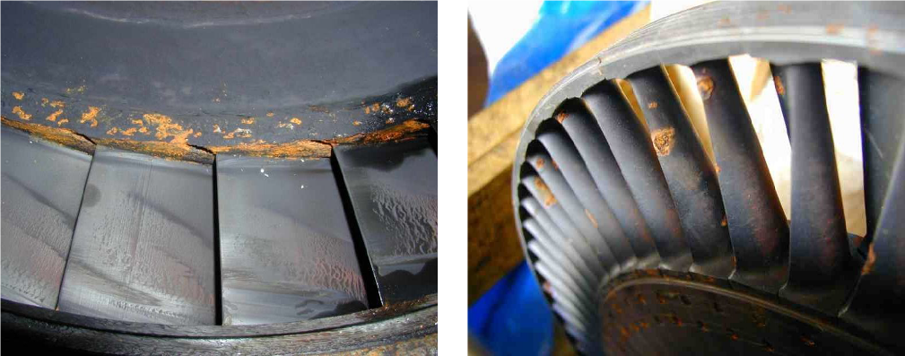

Slide 16
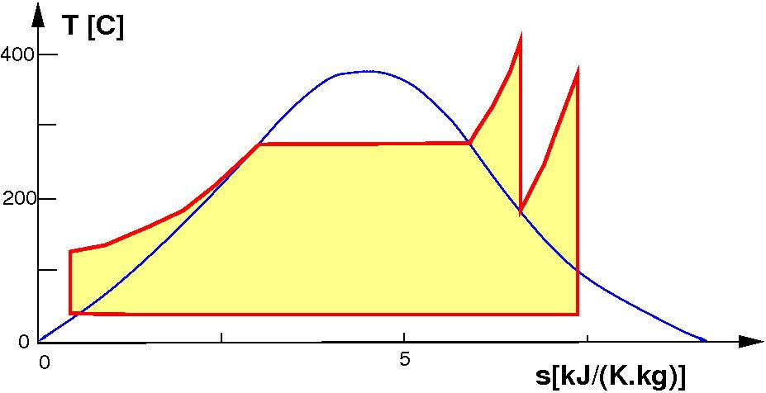
increase the pressure and temperature of steam, but limited by resistance of materials
preheat the water with residual heat of exhaust
reheat the vapour (superheater), feed a second turbine

Slide 17
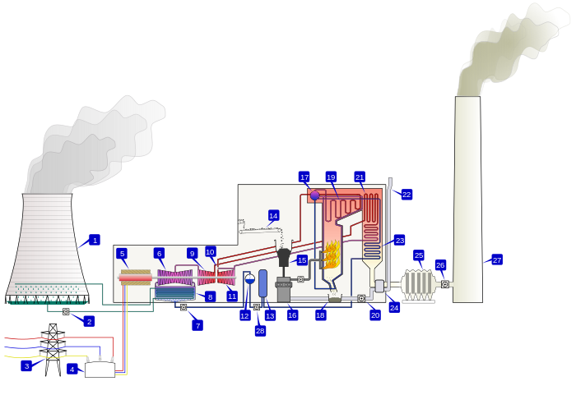
1. Cooling tower 10. Steam Control valve 19. Superheater
2. Cooling water pump 11. High pressure steam turbine 20. Forced draught (draft) fan
3. Transmission line (3-phase) 12. Deaerator 21. Reheater
4. Step-up transformer (3-phase) 13. Feedwater heat 22. Combustion air intake
5. Electrical generator (3-phase) 14. Coal conveyor 23. Economiser
6. Low pressure steam turbine 15. Coal hopper 24. Air preheater
7. Condensate pump 16. Coal pulverizer 25. Precipitator
8. Surface condenser 17. Boiler steam drum 26. Induced draught (draft) fan
9. Intermediate pressure steam turbine 18. Bottom ash hopper 27. Flue-gas stack

Slide 18
W₂
W₁
Q₂
Q₁
$$r=\frac{2,26+3,77}{11,53+2,9}=0.42$$
Notes:
Mesure graphique du rendement en utilisant la même méthodes.
- détente et compression sont verticales
- chauffage isobare avec changement d'état (isotherme pendant le changement d'état)
En fin de détente, on est dans la phase gazeuse

Slide 19
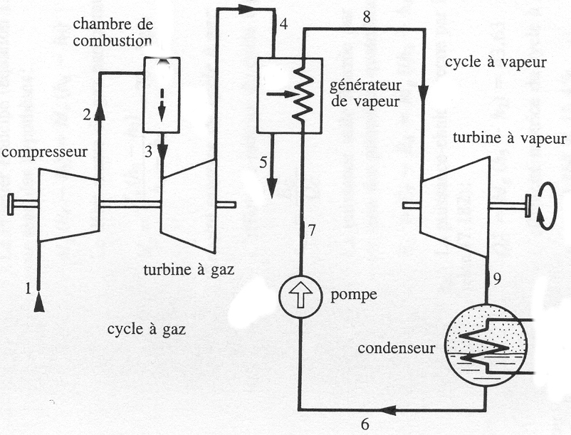

Slide 20
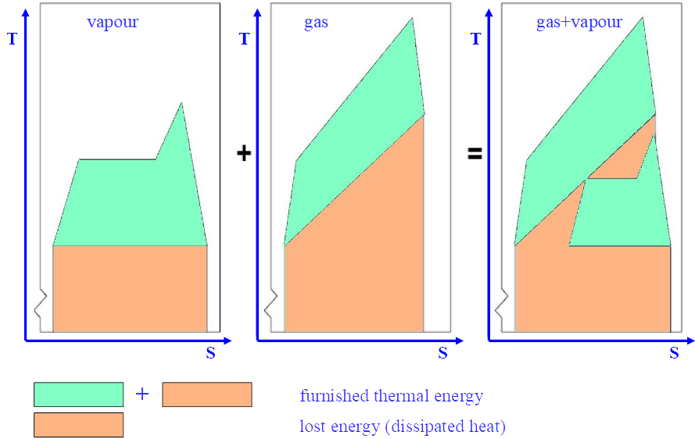

Slide 21
