Slide 1
PC 2 Greenhouse effect
PHY 555 – Energy & Environment
Erik Johnson, Mathieu de Naurois, Daniel Suchet
© Nicolas Wauters

Slide 2
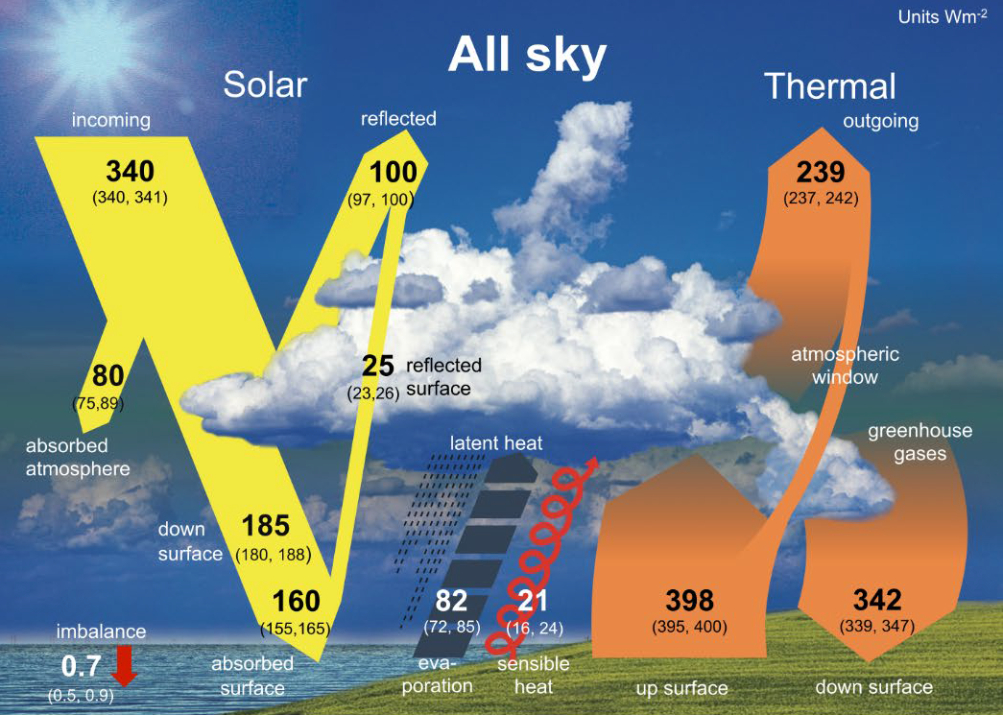
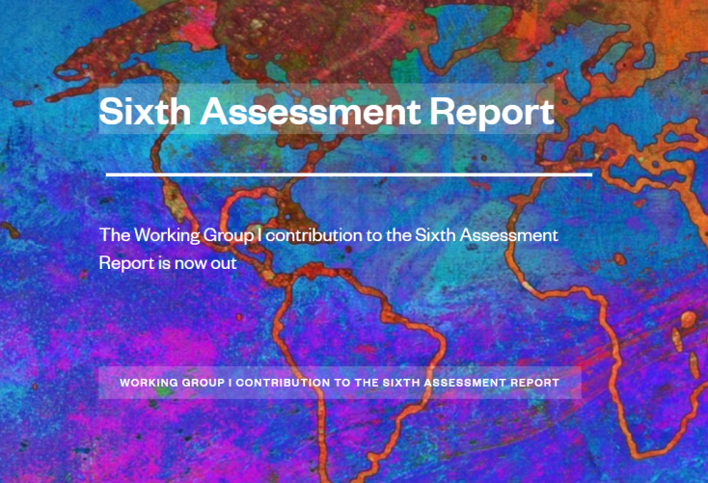
Earth energy budget

Slide 3
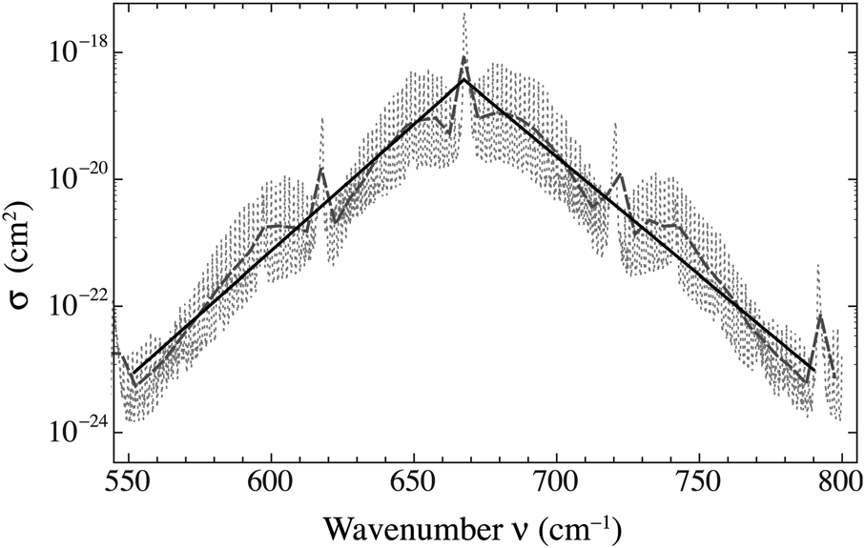
CO₂ radiative cross section

Slide 4
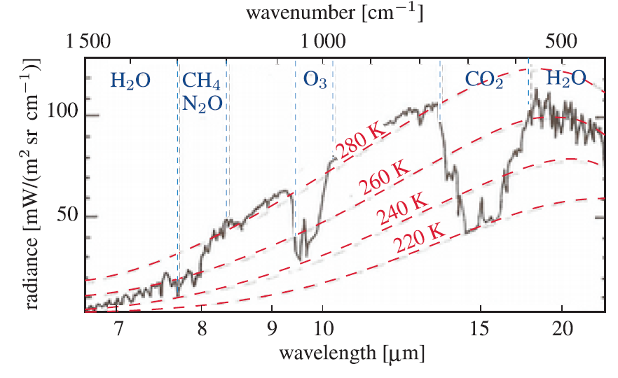
Earth emission to outer space
Credit: J.T. Houghton, Global Warming: The
Complete Briefing, Cambridge University Press (2004))

Slide 5
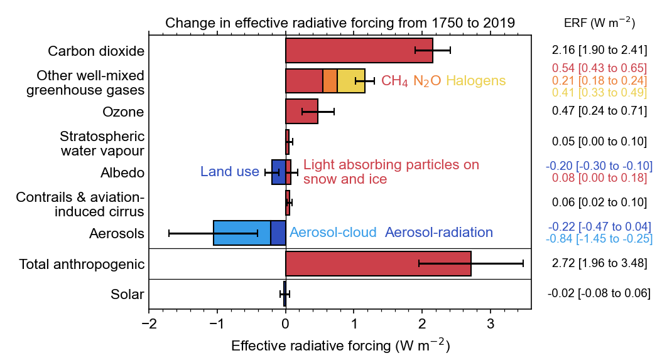
Other anthropogenic influence

Slide 6
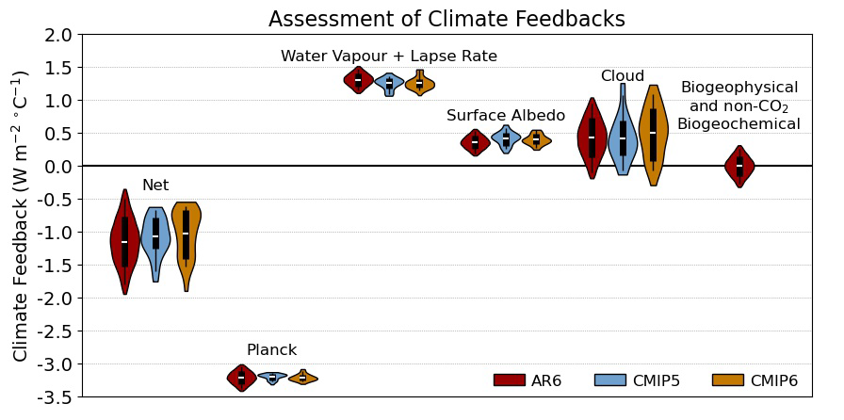
Feedback parameters

